Slide 1
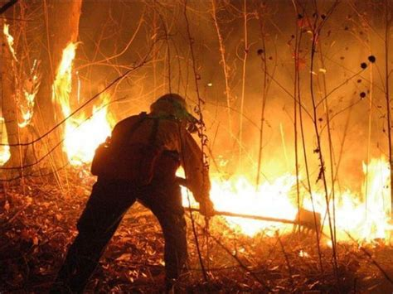



2023 Louisiana Wildfires
This expert-led plenary will feature key emergency managers on the frontlines of the 2023 Louisiana Wildfires as Louisiana was the number one state with the highest conditions for fire weather in the country last summer.

Slide 2
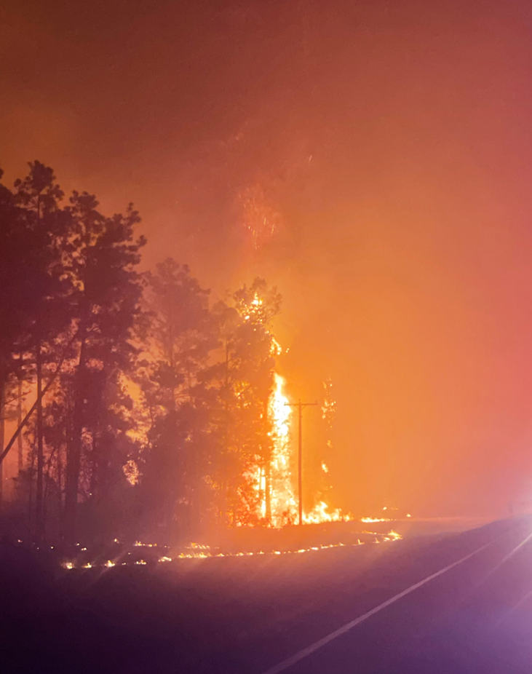

Overview of Fire Impact
Concentrated fires in Beauregard, Vernon and Rapides
Significant fire weather which created fire behaviors that was unpredictable.
Primary rural area with limited fire suppression resources and personnel
Novice understanding of wildfires, resourcing and incident management
Lack of wildfire preparedness and communication challenges
Tactical challenges on fire containment
Back tAgenda

Slide 3
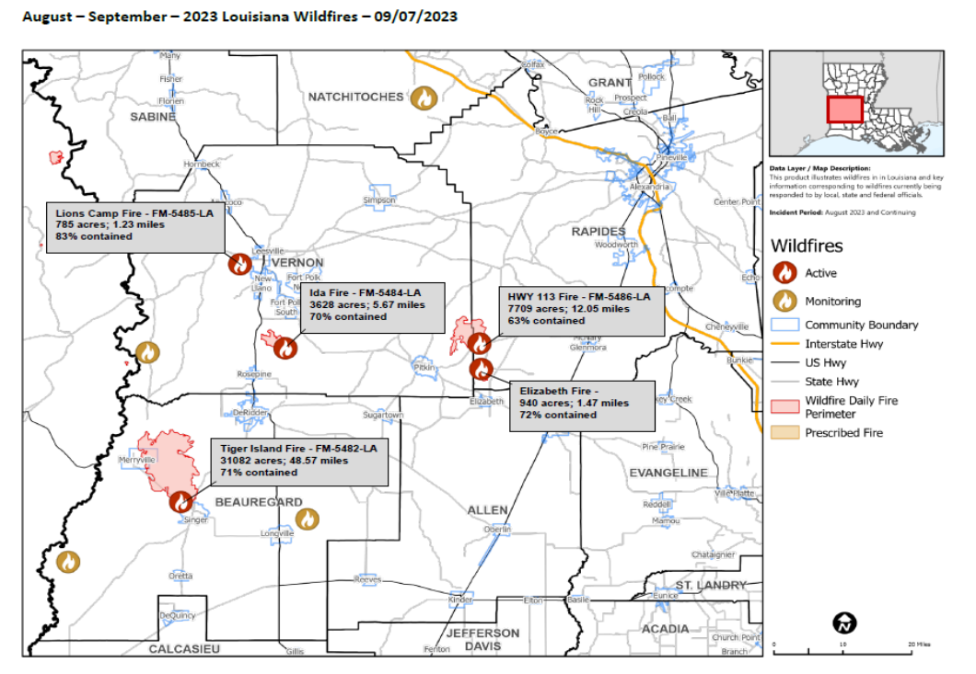
Back tAgenda

Slide 4
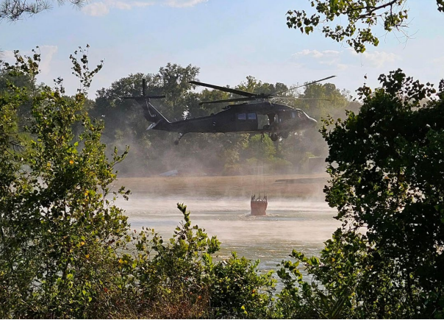
PLENARY PANELISTS
This panel will share their experience addressing community needs, integration with incident management teams and insights on best practices to improve wildfire response and management capabilities for future incidents.
Scott Greenmun, Beauregard OHSEP
Shannon Burgess, Beauregard OHSEP
Kenneth Moore, Vernon OHSEP
Angie Branton, Rapides OHSEP
Blackhawk, Hwy 113 Fire, 2023
Rapides/Vernon

Slide 5
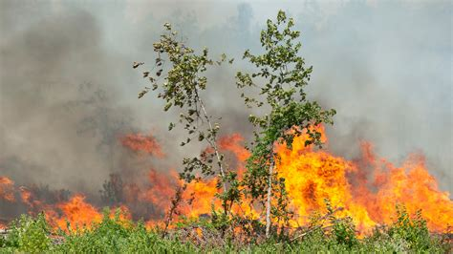
Objectives
This panel will share their experience addressing community needs, integration with incident management teams and insights on best practices to improve wildfire response and management capabilities for future incidents.
Immediate Needs/Priorities
Warning/Alerts/
Notifications
Command & Control
Coordination & Integration
Resources/Effective Deployment
Recommendations for Future Events

Slide 6
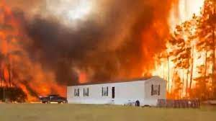
Immediate Needs/Priorities
Share Concerns for Community and Responders Based on Threat
Fire Weather and Fire Behavior Impacts
Messaging to Public
Continuous Extreme Heat & Drought Conditions
Dealing with Reburn
Evacuation Consideration
LA SFM
Sept. 2023

Slide 7
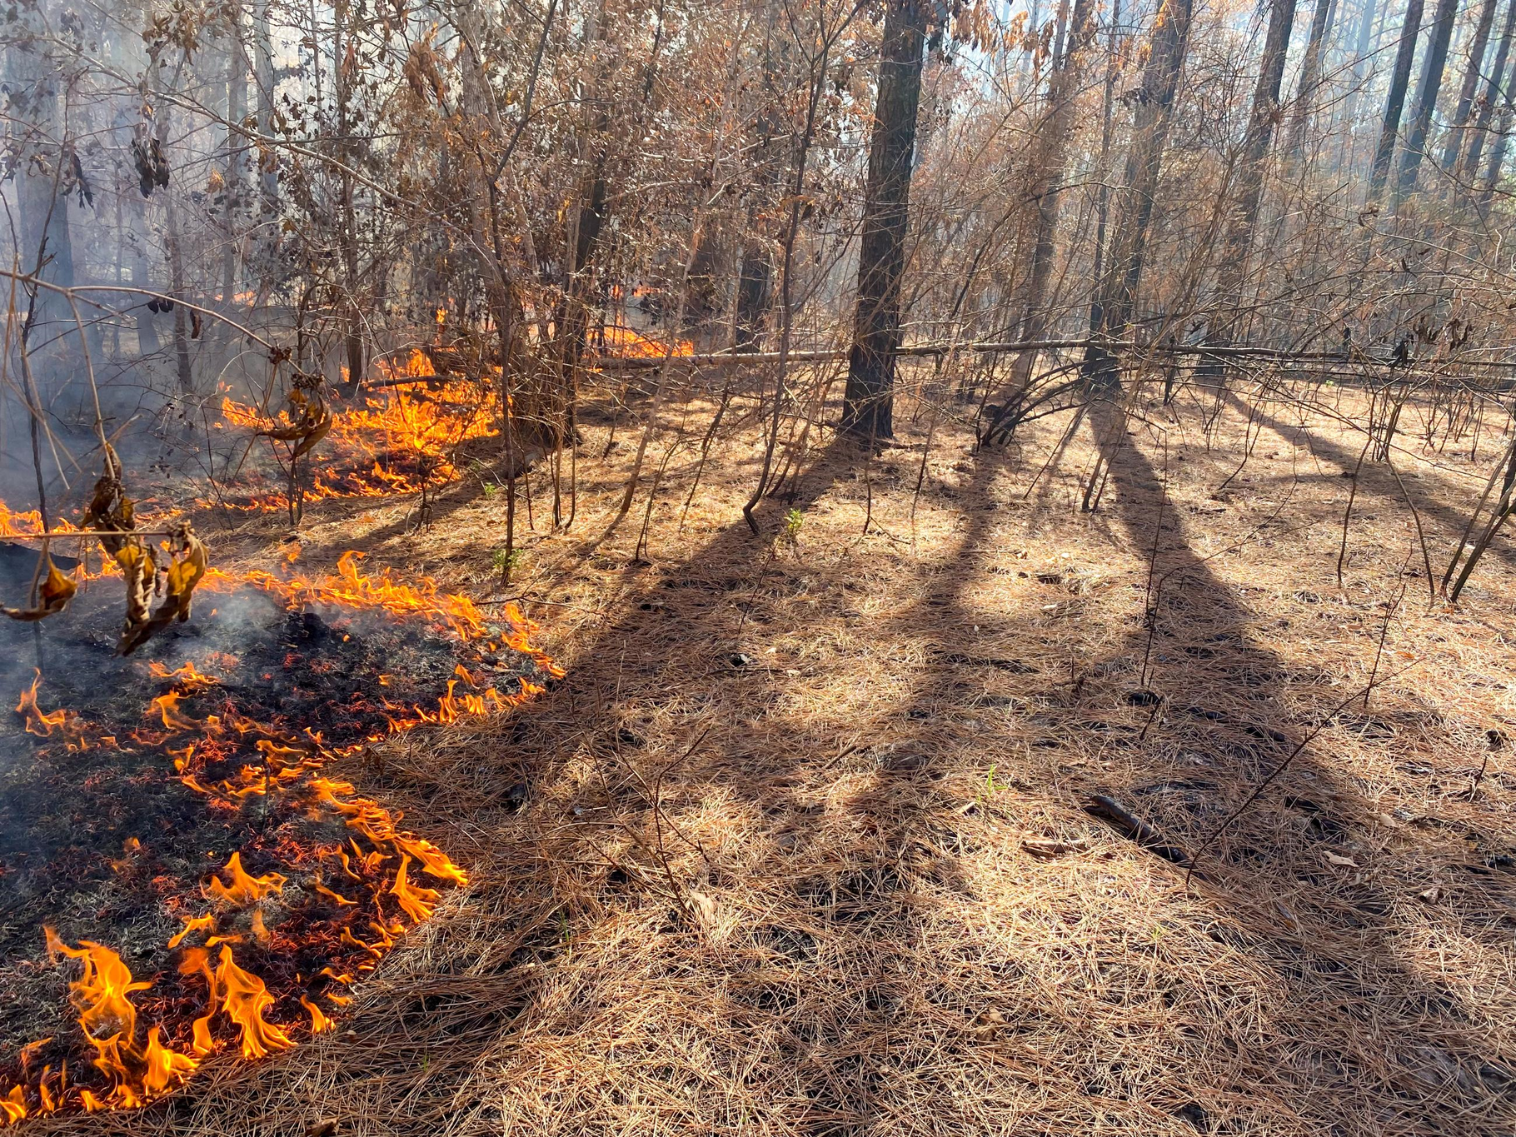
Warnings/Alerts and Notifications
Informing the Public and Stakeholders are Essential for Public Safety
Reburn - Beauregard Parish
DeRidder, LA 2023

Slide 8
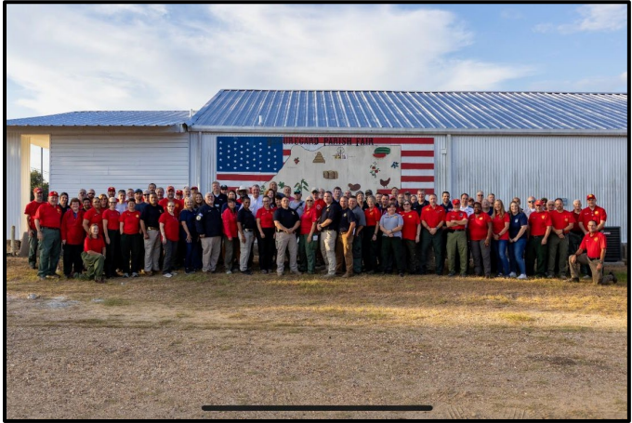
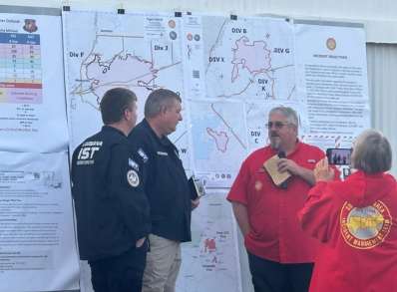
Command & Control
Sharing the Unique Elements from Wildfire Threats
Beauregard Parish
DeRidder, LA 2023

Slide 9
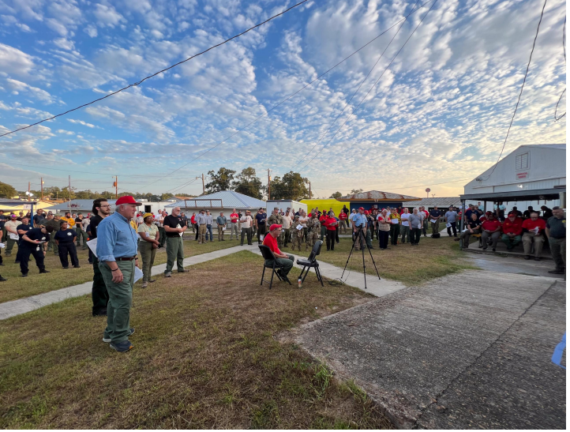
Coordination & Integration
Key Elements for Effective Incident Management
Southern Compact, Red Team
AM Operations Briefing
DeRidder, LA 2023

Slide 10
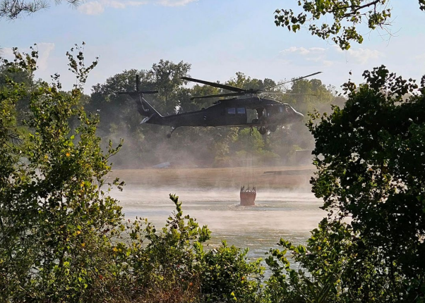
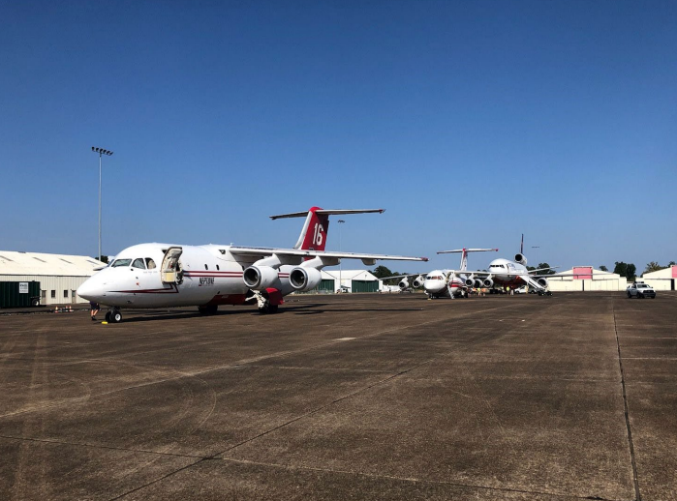
Resources Management/Effective Deployment of Resources
Sharing the Unique Elements from Wildfire Threats
Blackhawk, Hwy 113 Fire, 2023
Rapides/Vernon
Larger Aerial Tanker
Rapides

Slide 11
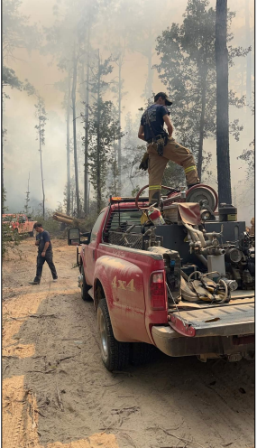
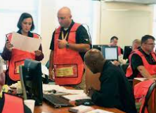
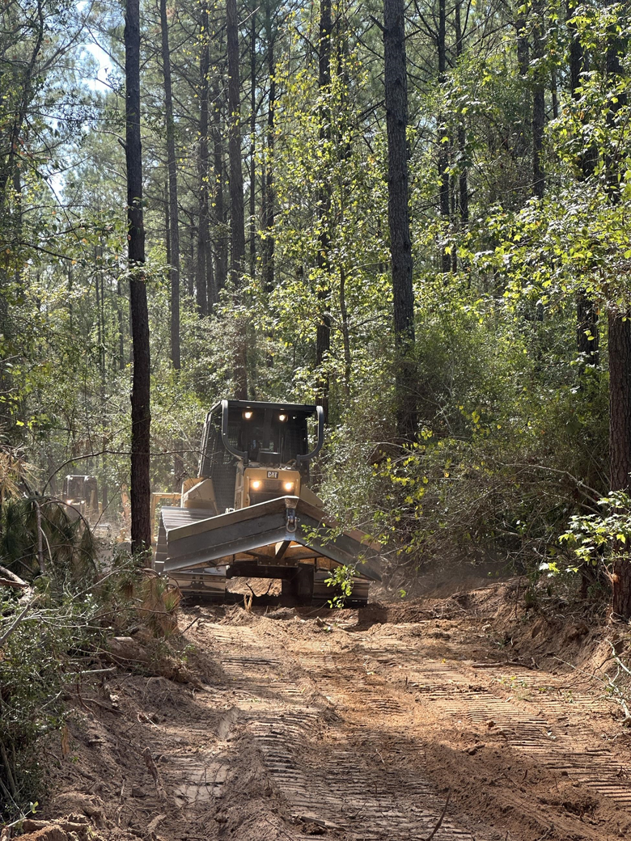
Recommendations and Planning for Future Wildfires
Briefly elaborate on what strategies and tactics you have been planning from what you learned last summer.
Partnerships
Resources
Education
Training

Slide 12
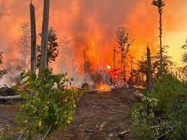
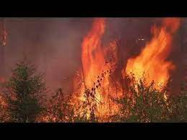
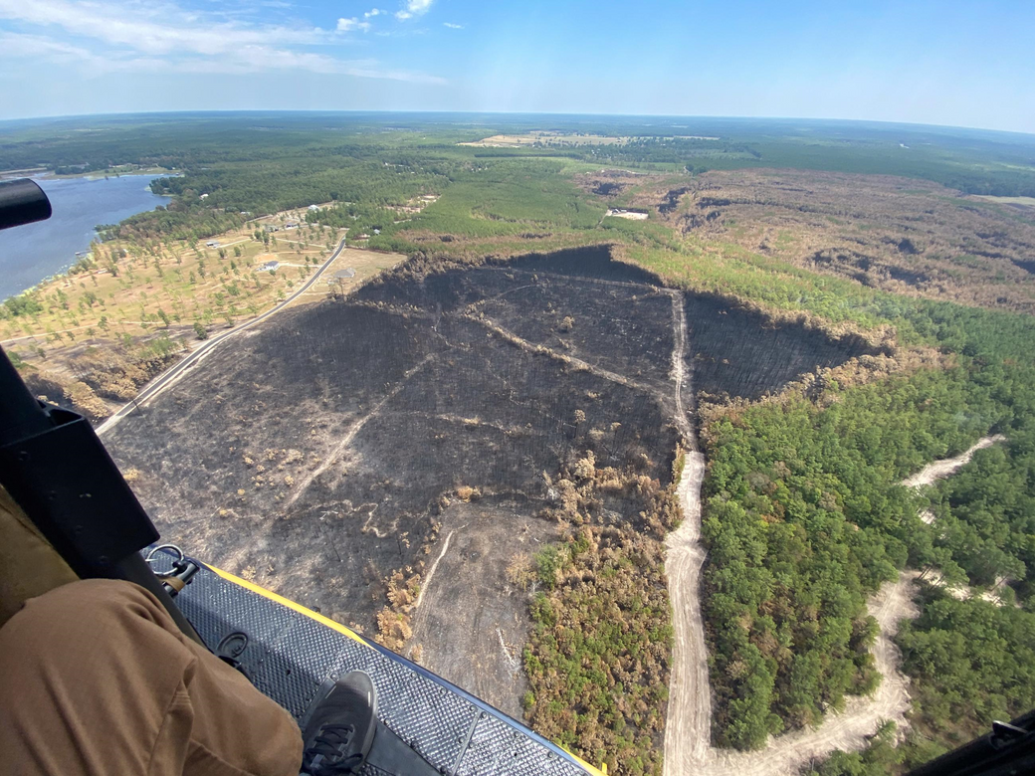
Questions, Answers & Comments

